Slide 1
Virtual Learning Back to School
Kisha Haralson
1st Grade

Slide 2
Introduction
My name is Kisha Haralson. I have worked for Madison County School District my entire career. I started my career teaching Kindergarten for three years. Since then, I have taught all grades on the elementary level (K-5).
I graduated from Madison Central High School. I am a four times graduate of Mississippi College. I hold a Bachelor of Science in Elementary Education, a Master’s degree in Education, an Educational Specialist, as well as a Master’s degree in Educational Leadership.

Slide 3
Creating a Successful
Learning Environment
Minimize distractions and background noises.
Please ensure the mic is muted.
Wear clothing appropriate for school.
Be sure that what is said or typed is kind and appropriate.

Slide 4
School Day
School hours are 7:30 – 2:30
Virtual Learning students will be on an Activity Schedule on Fridays

Slide 5
Attendance
In order to be considered “present” for Virtual Learning, students must attend live meetings and/or complete classwork. If your student is unable to attend a live meeting, he or she may still be counted “present” as long as classwork due that day is submitted by 11:59 p.m. of the same day.

Slide 6
Daily Schedule
1st Grade Daily Schedule
8:00-8:20 Morning Meeting (LIVE)
8:20-8:35 Phonemic Awareness (LIVE)
8:35-8:45 Brain Break
8:45-9:00 Shared Reading (LIVE)
9:00-10:15 ELA Small Groups + Phonics (LIVE) & Independent Centers (Canvas)
11:45-12:05 Math Lesson (Canvas)
12:05-1:00 Math Small Groups (LIVE) & Independent Centers (Canvas)
1:00-1:45 Writing Lesson (Canvas)
1:45-2:00 Science/Social Studies

Slide 7
Special Classes
We are thrilled to be able to offer a full range of special activity classes for our virtual learners.
Monday Tuesday Wednesday
Music PE Art
Thursday Friday
Counselor’s Corner. Library

Slide 8
Accessing Classwork
Virtual learning classwork will primarily consist of Microsoft Teams meetings with your teacher and independent work on Canvas.

Slide 9
Assessments
Assessments are used to help teachers gauge a student’s understanding of the content. We ask that you allow your child to participate in assessments without intervening or helping. This gives us the best picture of what your child understands so that teachers can plan appropriate instruction.

Slide 10
Resources for Instruction
Math:
enVision
DreamBox
Number Corner K-2
ELA:
RAZ Kids Plus
Pathblazer
LLI

Slide 11
Math Manipulatives
Students will receive math manipulatives and math workbooks. More information will be provided in the upcoming days.

Slide 12
How can parents help?
Be conscious of background noises (phone calls, the dishwasher, siblings, pets, etc.) during live sessions.
Wait time … during live meetings give your child time to think and answer without assistance (this allows me to gauge student understanding)
Make sure classwork reflects the student’s ability (this helps me know what the student needs)
Stay Positive!!

Slide 13
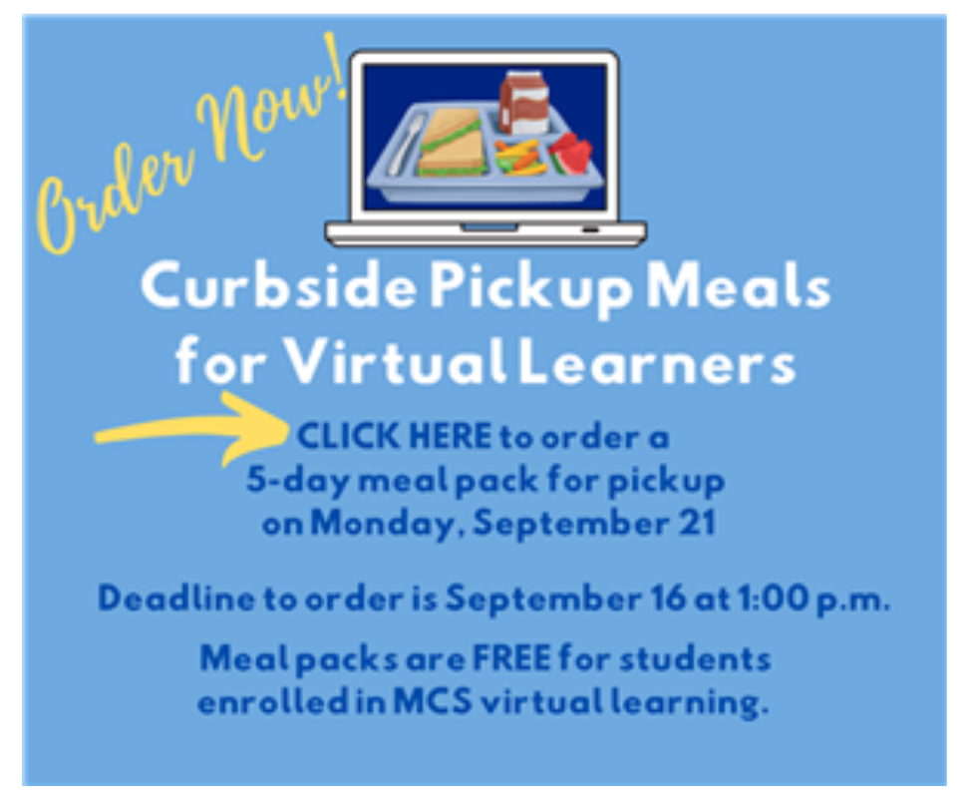
Virtual Meal Pickup
5 Day Meal Packs will be distributed at your child’s school every Monday from 10am – 12am.
Meals are currently FREE, but they must be pre-ordered.
You can find more information at: www.madison-schools.com/virtuallearning

Slide 14
Contact Information
Our goal is to maintain an open line of communication as we work together to provide the best education possible for your child.
Please feel free to contact me at lharalson@madison-schools.com
More information regarding Virtual Learning, including contact information, can be found at www.madison-schools.com/virtuallearning

Slide 15
Thank you for entrusting us with the education of your child. We look forward to a great semester!

